Slide 1


Slide 2
ACTION MAN 2024
GENRE: Action/Adventure
TARGET AUDIENCE: Teens and Adults
PLATFORM: Xbox Series X, PC, PS5

Slide 3
Game Story
As a famous extreme sports star, Alex Mann is training for a big tournament when he is suddenly attacked by a deadly assassin. When his life is saved by an individual from his past, he is brought into the world of espionage and counter-terrorism as a member of the Secret Intelligence Service.
Along the way,he not only learns of his long lost brother, a missing SIS agent but of a secret ability buried in his mind that made him the amazing athlete he is….an ability that is sought after by the evil bioterrorist, Dr X.
Can Alex maintain his cover and stop Dr X’s evil plans before its too late?

Slide 4
Game Features
Third person action gameplay.
Vehicular combat and awesome set pieces.
Work alongside Action Force while playing in the G-games with help from Team Xtreme.
Face the evil Dr X and his nefarious army.

Slide 5
Gameplay Summary
Action Man is a third person Action Adventure game that will have Alex Mann travelling the world with his team thwarting the evil plans of Dr X.
You will engage in several missions facing Dr X and his army with a vast array of gadgets, vehicles, non-lethal weapons his Special AMP ability and teammates, whether you are sneaking in using stealth or going guns-blazing or a combination of both.
You’ll also have to maintain your cover as a extreme Sports athlete and participate in one of the biggest tournaments in the world.

Slide 6
Gameplay Details
Alex Mann is a 24 year old athlete that is considered by most people as athletically gifted. He is capable of many peak physical feats to move from one spot to another through various obstacles and environments.
He is also a talented Martial Artist as well as a skilled marksman and vehicular pilot/driver that can push most vehicles to their limits.

Slide 7
Gameplay Details
Alex will not go in empty handed as he will be able to choose from a vast array of weapons such as non-lethal firearms that shoot electrically charged projectiles.
He can also utilize explosive devices like grenades of different types and EMPs and melee weapons like Staves, swords,etc.
While Alex is indeed a physically fit athlete capable of peak human feats, he is not above utilizing various gadgets and gear like grappling hooks, decrpters, etc to aid him at the best suited situations.

Slide 8
The G-Games Tournament
The G-games is one of the biggest extreme sports associations in the world and this specific tournament is one held every 5 years that Alex has been heavily preparing.
A competition where the best of the best gather to participate in a set of gruelling extreme sports challenges that will test the skill of these athletes with the eyes of the world laid upon them. Alex has been training for a long time for this and intends to let nothing get in his way...not even Dr X’s evil schemes.

Slide 9


AMP (Advanced Macro Probability) Ability
In addition to his gear, Alex has access to his AMP ability, a mental ability that allows the Player to see highlighted objects and plan out ideas and tactics that would benefit the situation they're in like shooting off a fuel tank on a moving platform or seeing objects you could you to parkour to a degree,etc.

Slide 10
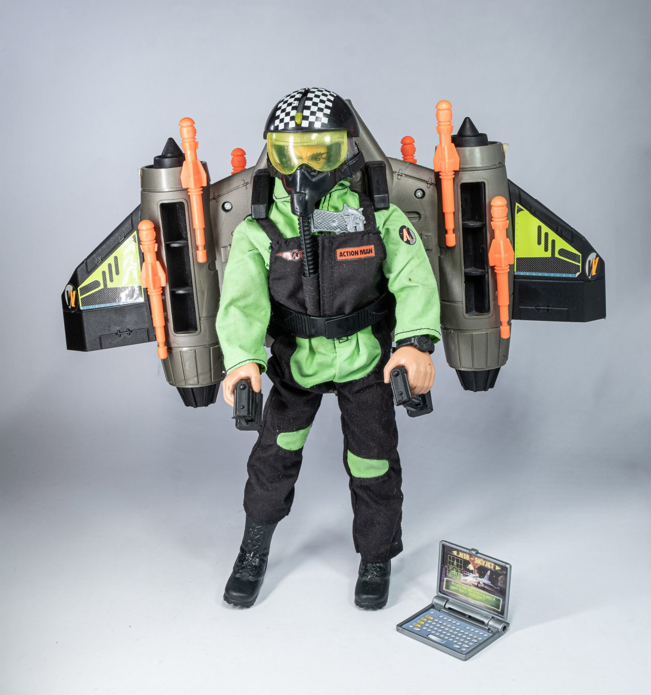
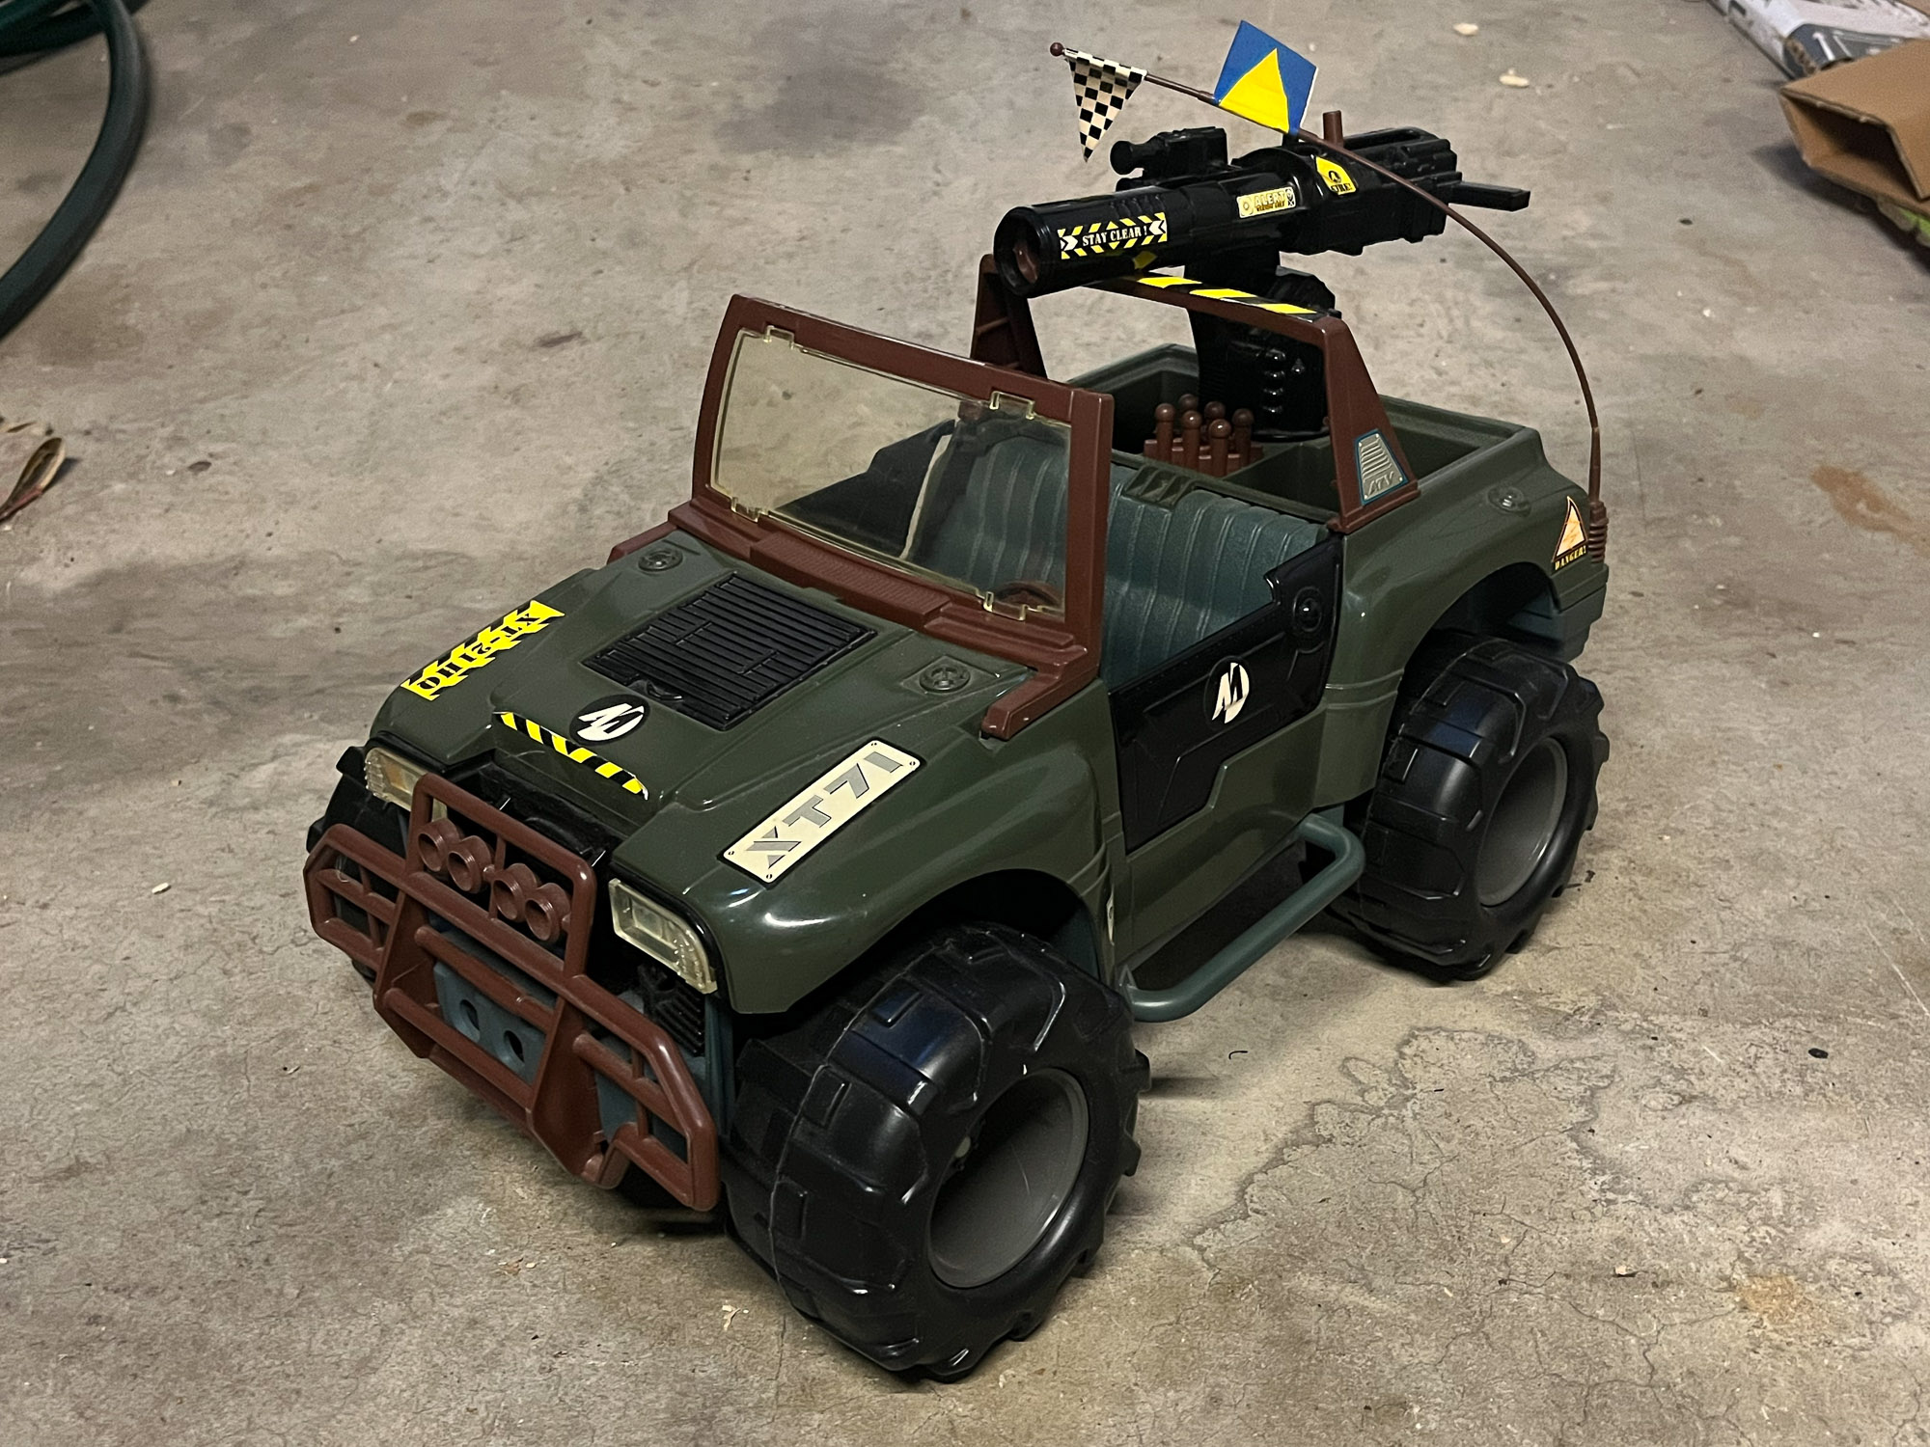
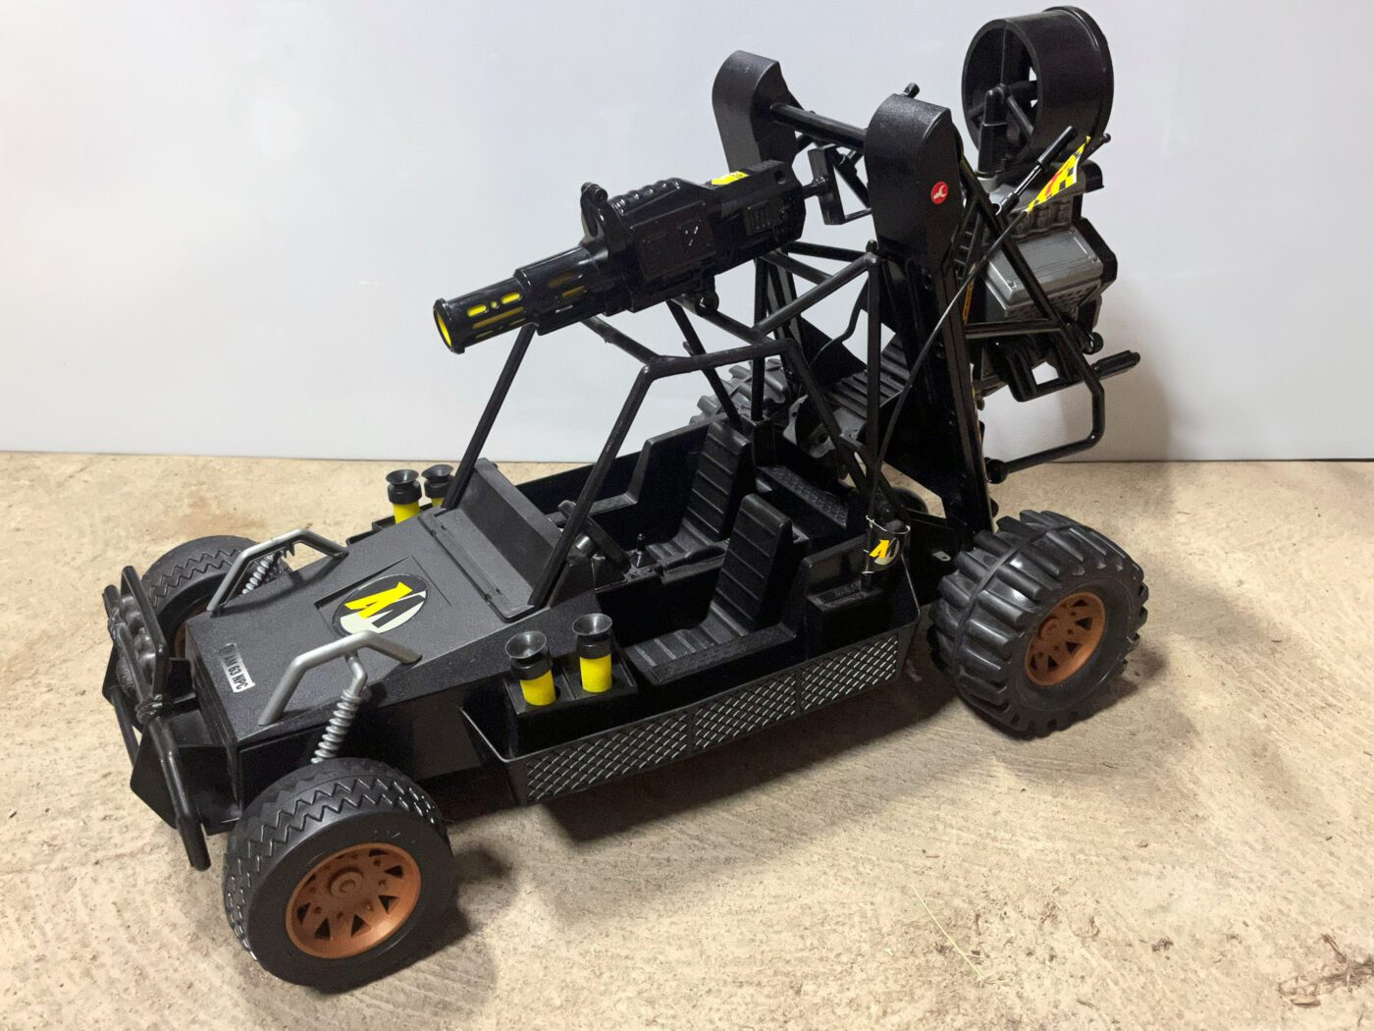
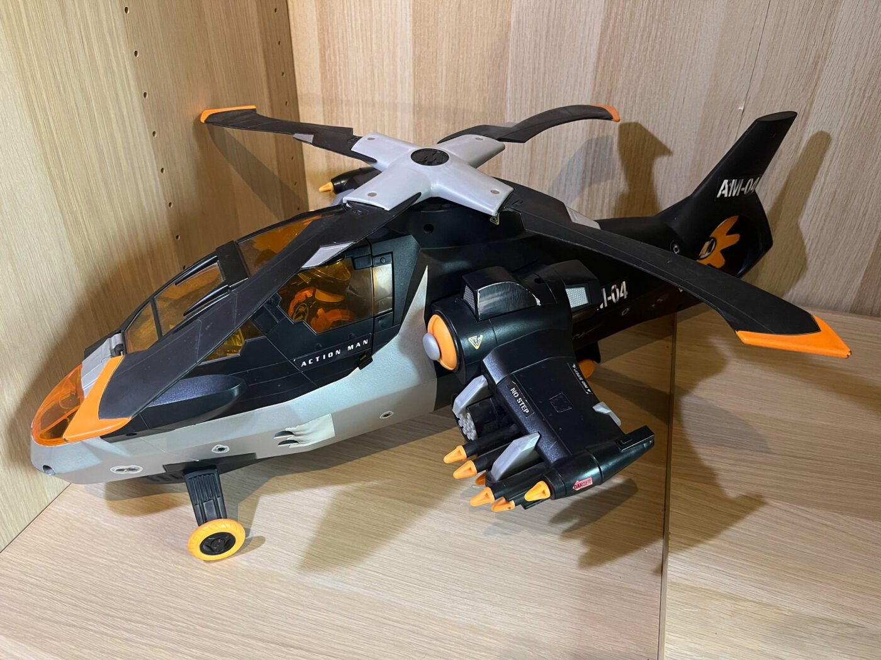
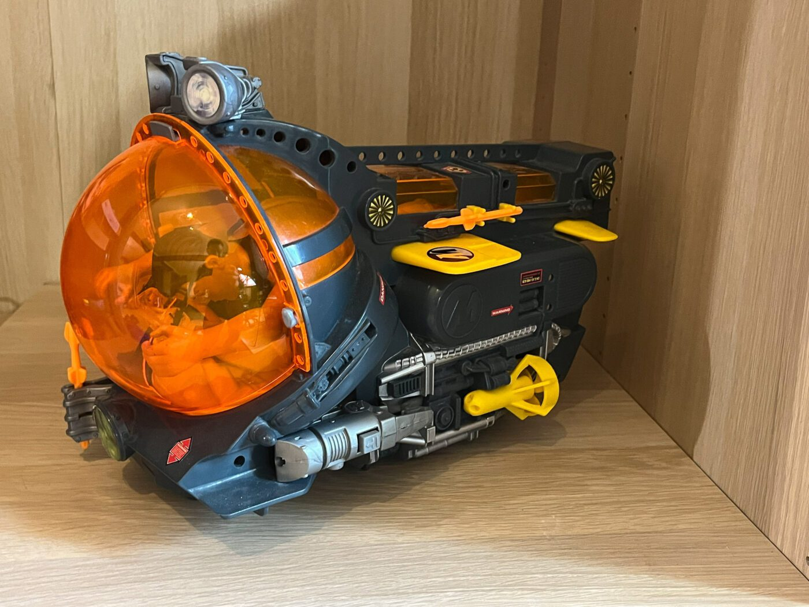
Vehicles
Throughout his adventure, Alex gains access to an assortment of vehicles that he can drive/pilot in various operations such as cars,bikes,helicopters, etc to accomplish the more on-road, aerial and water based objectives while combating Dr X’s forces.

Slide 11

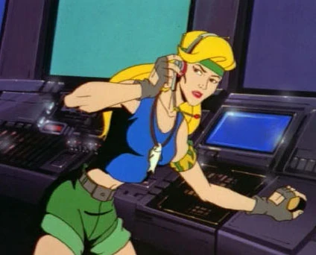
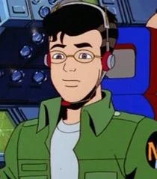

Teammates (Action Force)
Knuck Williams: is an agent that specialises in mechanics and demolitions.
Natalie Poole: an agent that specialises in long range marksmanship
Jacques: an agent that specialises in tech development and hacking
Mercy Gale: One of the SIS’s best agents assigned to the team as a liaison to the group that specialises in infiltration.

Slide 12




Teammates (Team Xtreme)
Grinder: The pilot of the team’s flying home and Alex’s best friend.
Fidget: The team’s humorous and spunky camerawoman and social media manager that never backs down from anything.
Ricky Singh-Barnes: The team’s manager and PR handler for the team.
Raid: The German Shepard mascot and pet of the team that will loyally stand by the team no matter what.

Slide 13
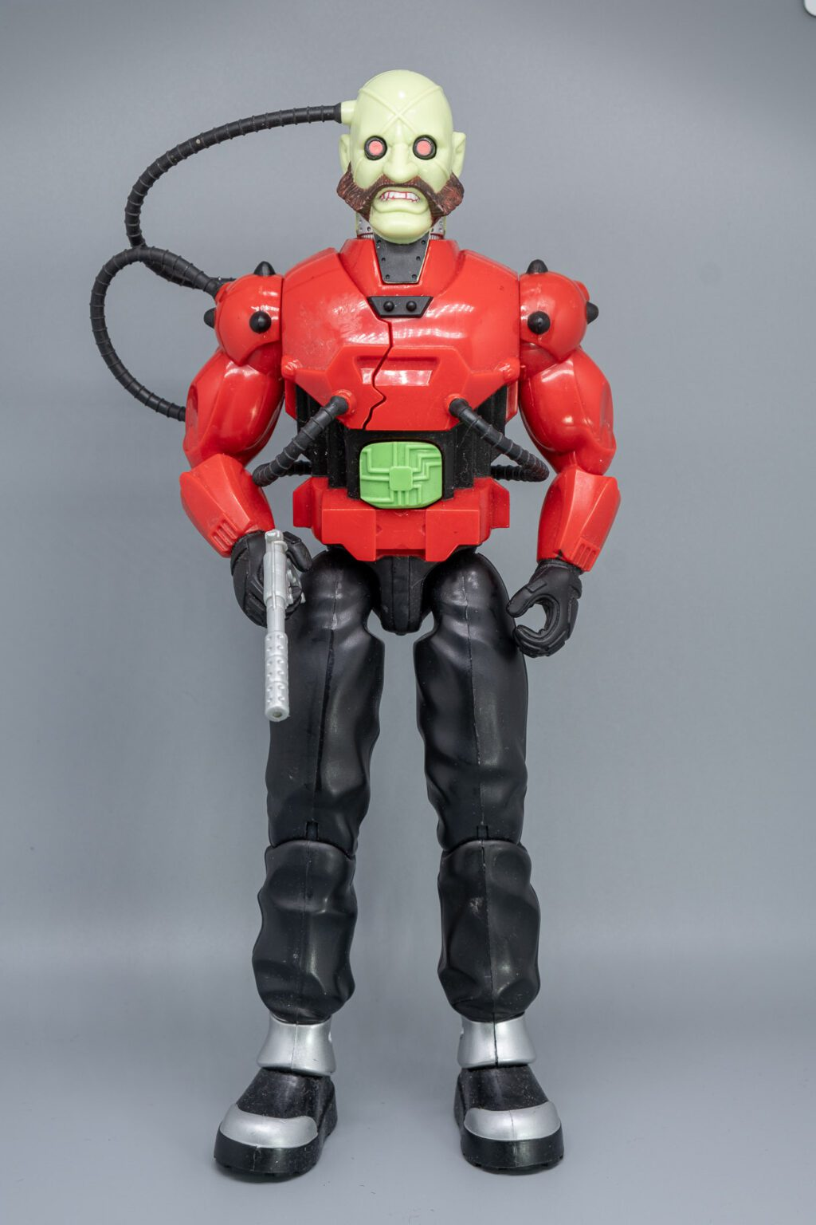
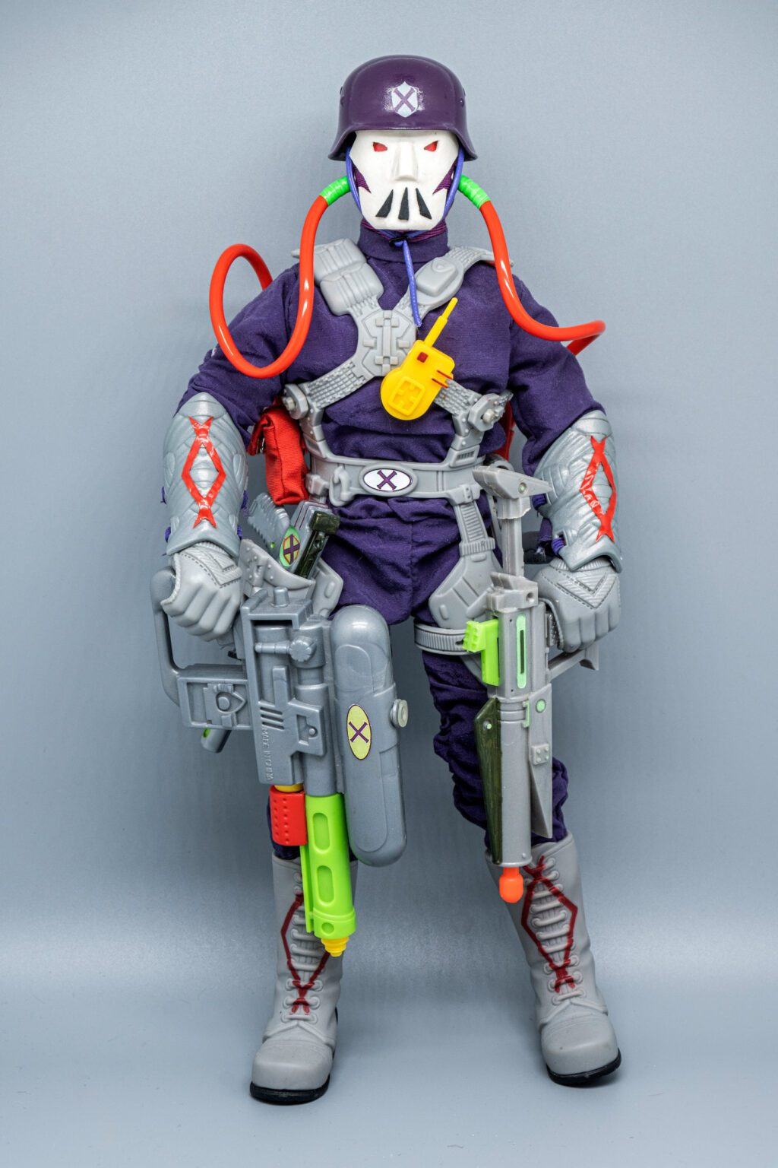
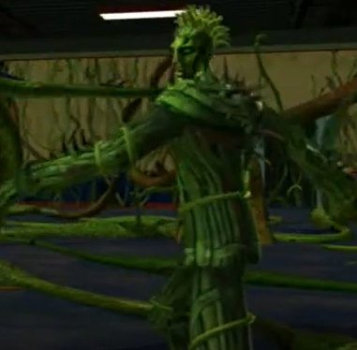
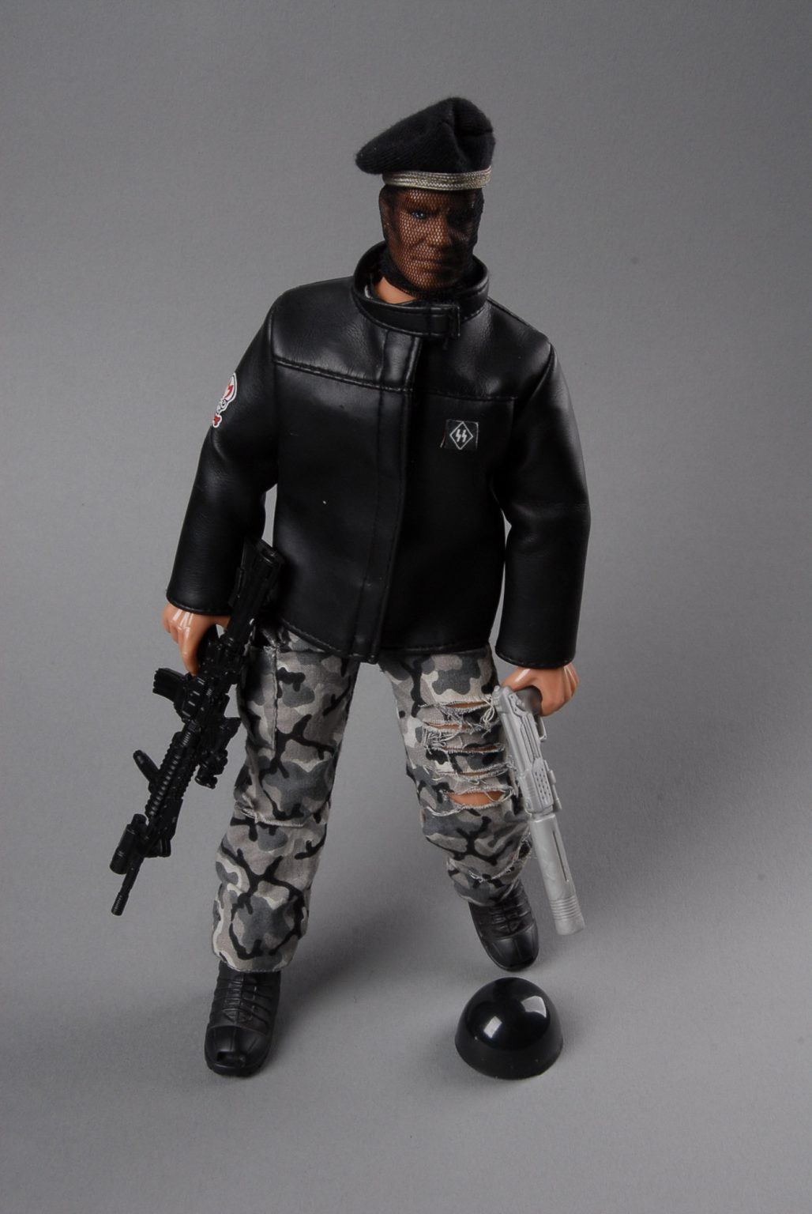
Enemies
X-Bot: These mechanical fiends were created to serve as Dr X’s basic attack troops.
X-Trooper: Criminals and kidnapped victims that have been brainwashed and modified into soldiers for Dr X
Toxic Troopers: Created by Prof Gangrene, these creature serve as his minions and soldiers that can be very difficult to face with their chemical weapons
Mercenaries: These minions for hire will unfortunately take any job from the right person for the right price

Slide 14


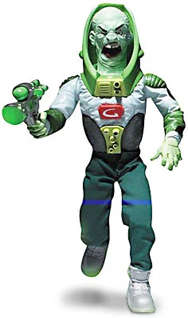

Bosses
  Asazi: An assassin-for-hire sent by Dr X to hunt down and assassinate Alex Mann
  Tempest: A meteorological genius that after an experiment gone wrong gains weather control abilities and threatens to use them against those that wronged him.
  Prof Gangrene: A demented toxicologist that has been experimenting on innocent people to create the perfect toxin.
  Dr X: A mad scientist obsessed with world domination that has mysterious ties to Alex Mann

Slide 15
Production Specs
Team numbers: 120
  Art: 50
  Programming: 30
  Design: 20
  Etc: 20
Software: UE5, Autodesk Maya, Motionbuilder, Substance
Development time: 4 years
Budget: £70,000,000

Slide 16
DLC/ Monetisation
Additional levels and missions
Additional costume packs
Additional weapons

